Slide 1
DNS-Domain Name Server

Slide 2
DNS: domain name system
people: many identifiers:
SSN, name, passport #
Internet hosts, routers:
IP address (32 bit) - used for addressing datagrams
“name”, e.g., www.yahoo.com - used by humans
Q: how to map between IP address and name, and vice versa ?
Domain Name System:
distributed database implemented in hierarchy of many name servers
application-layer protocol: hosts, name servers communicate to resolve names (address/name translation)
note: core Internet function, implemented as application-layer protocol
complexity at network’s “edge”

Slide 3
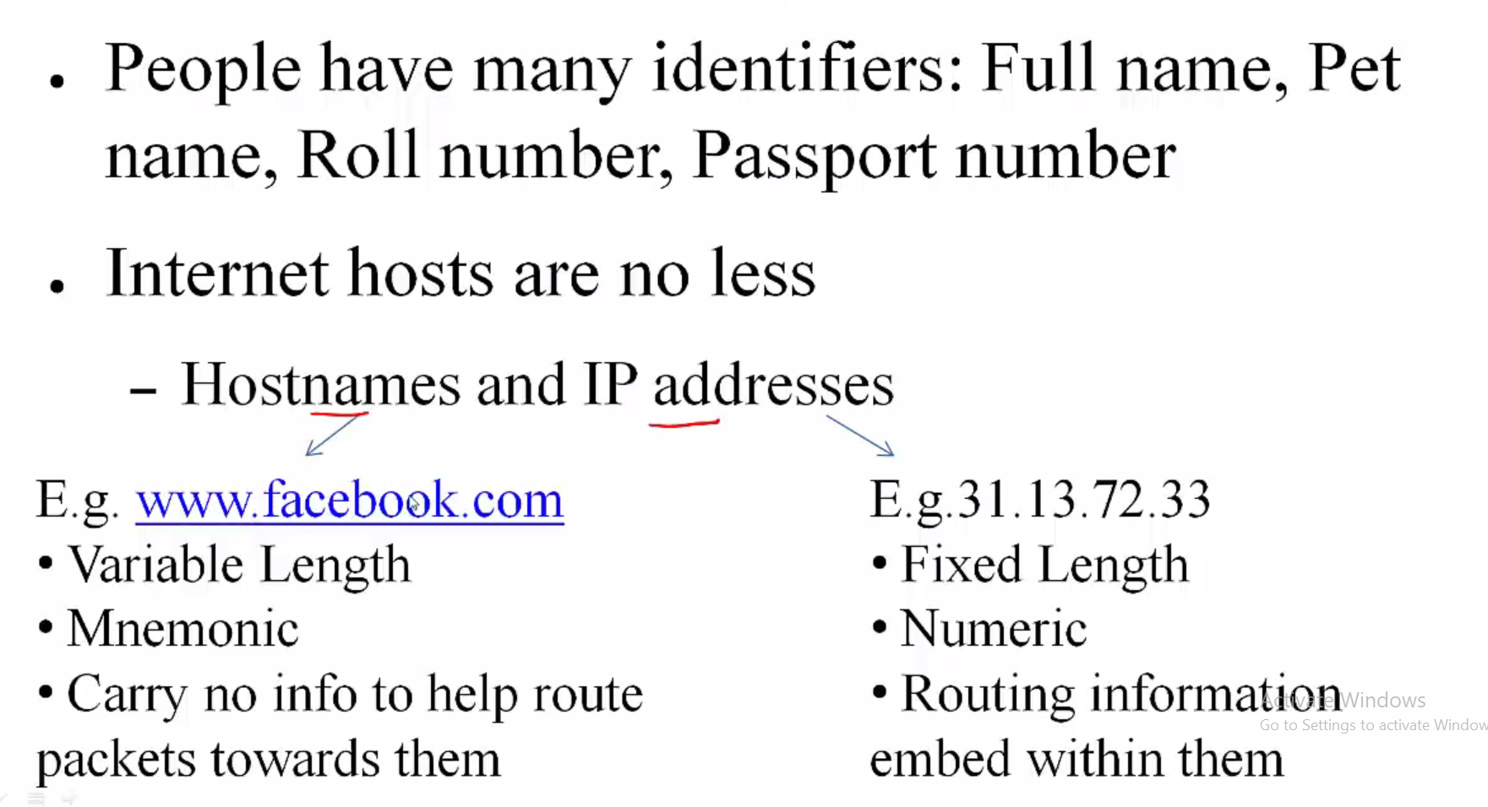

Slide 4
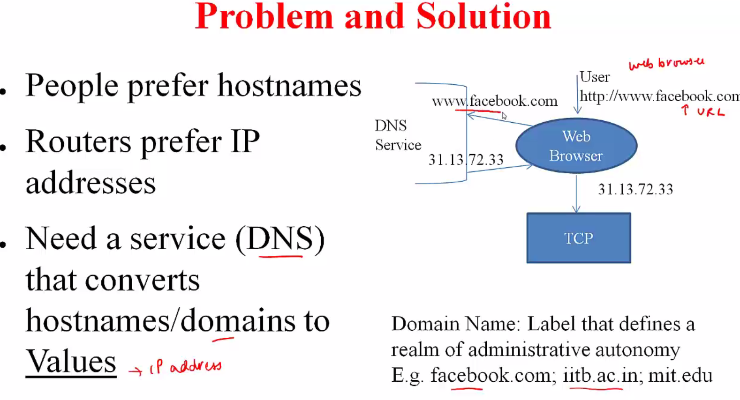

Slide 5
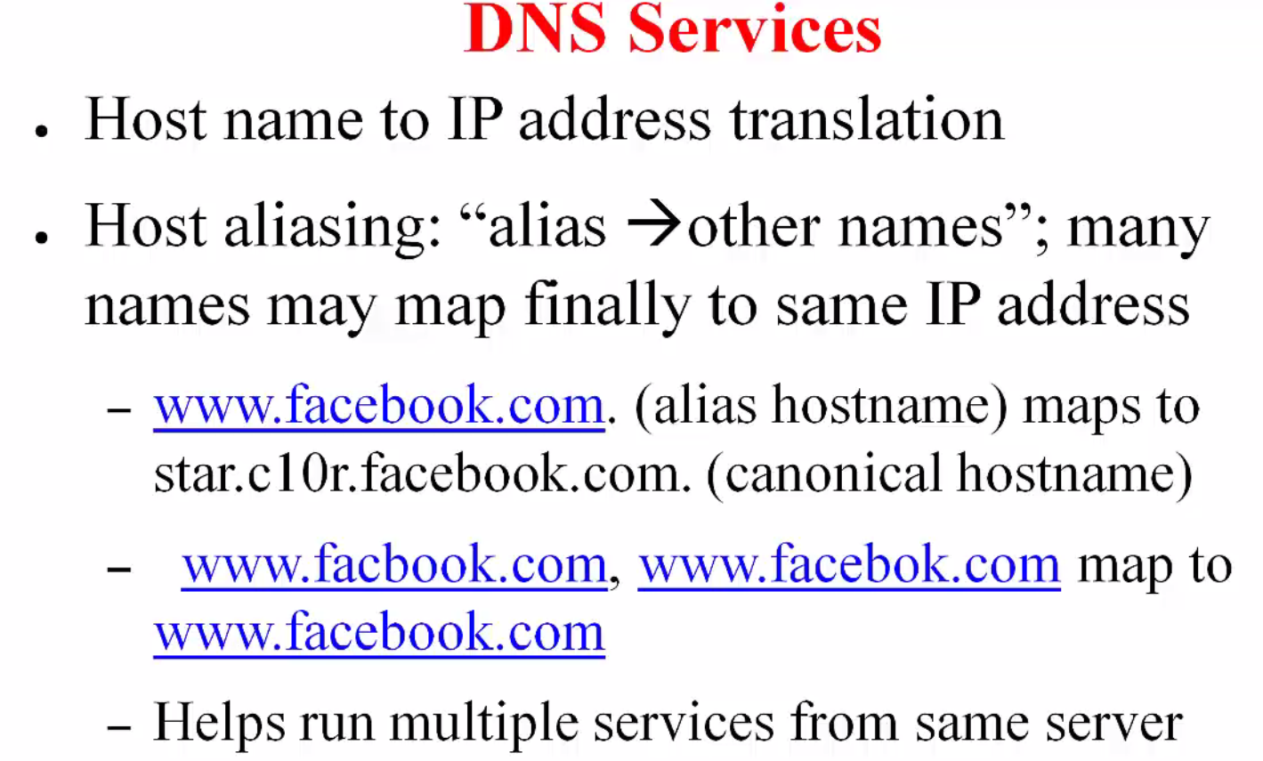

Slide 6
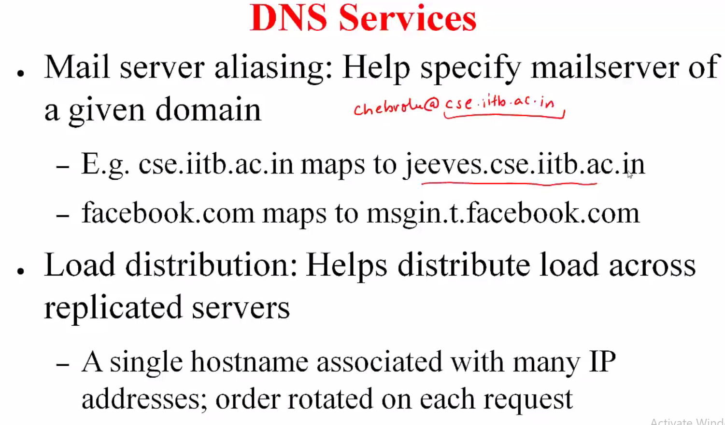

Slide 7
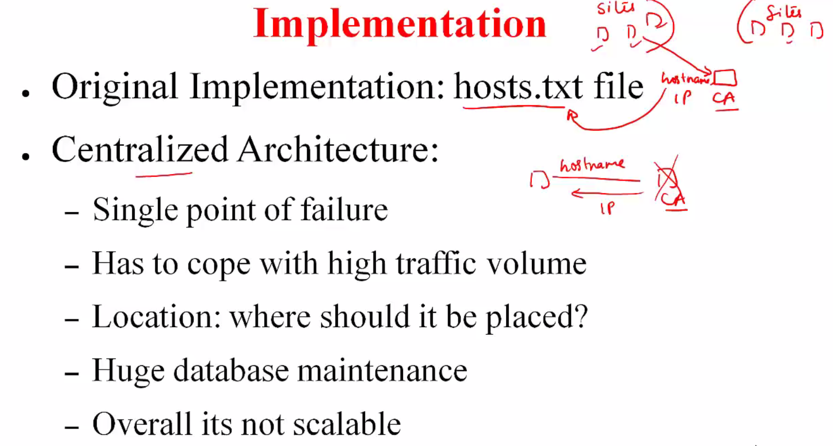

Slide 8
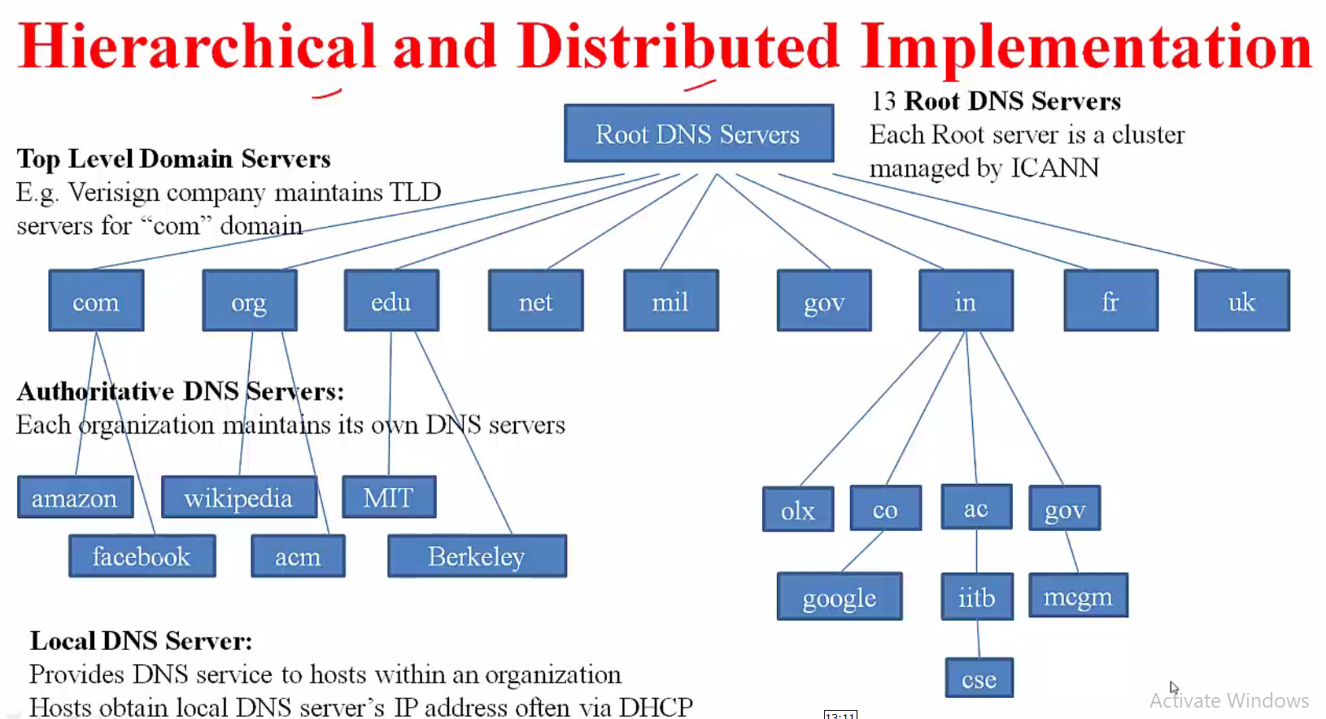

Slide 9
TLD, authoritative servers
top-level domain (TLD) servers:
responsible for com, org, net, edu, aero, jobs, museums, and all top-level country domains, e.g.: uk, fr, ca, jp
Network Solutions maintains servers for .com TLD
Educause for .edu TLD
authoritative DNS servers:
organization’s own DNS server(s), providing authoritative hostname to IP mappings for organization’s named hosts
can be maintained by organization or service provider

Slide 10
Local DNS name server
does not strictly belong to hierarchy
each ISP (residential ISP, company, university) has one
also called “default name server”
when host makes DNS query, query is sent to its local DNS server
has local cache of recent name-to-address translation pairs (but may be out of date!)
acts as proxy, forwards query into hierarchy

Slide 11
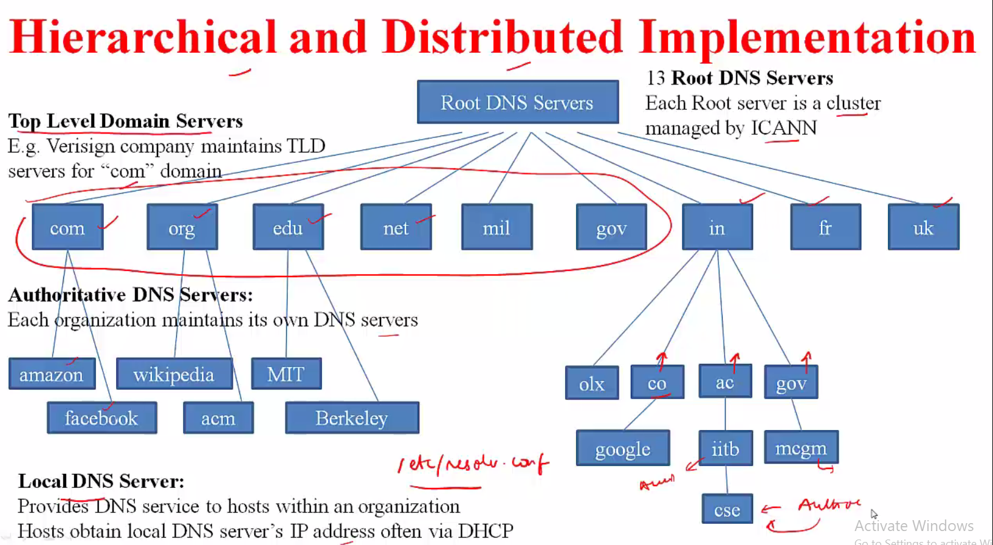

Slide 12
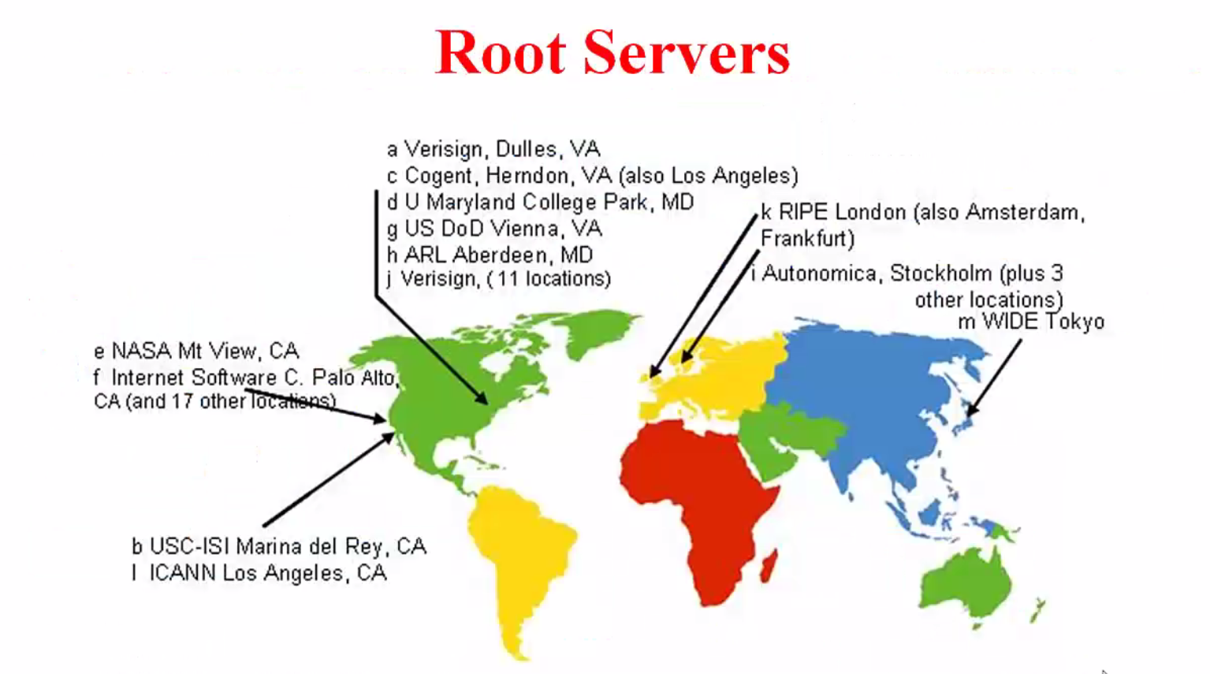

Slide 13
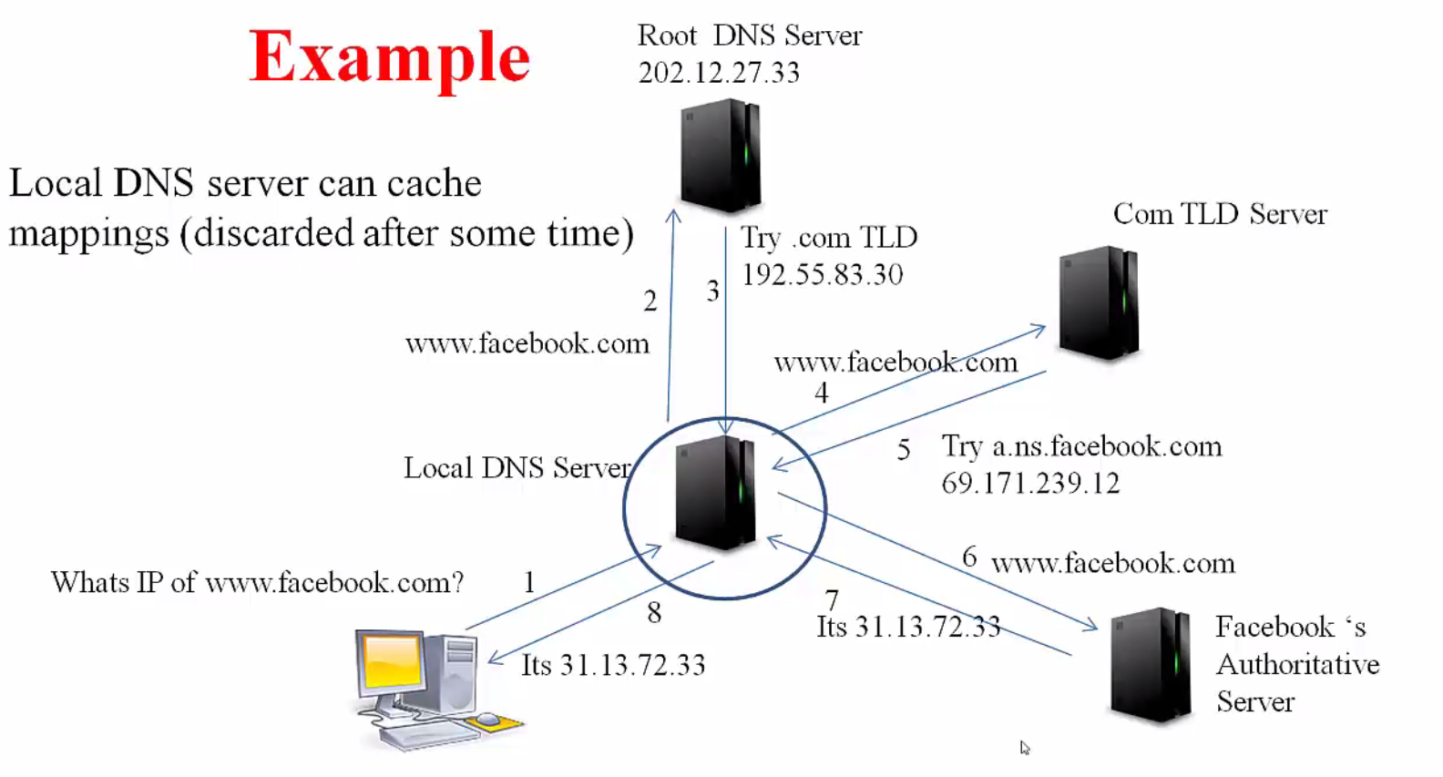

Slide 14
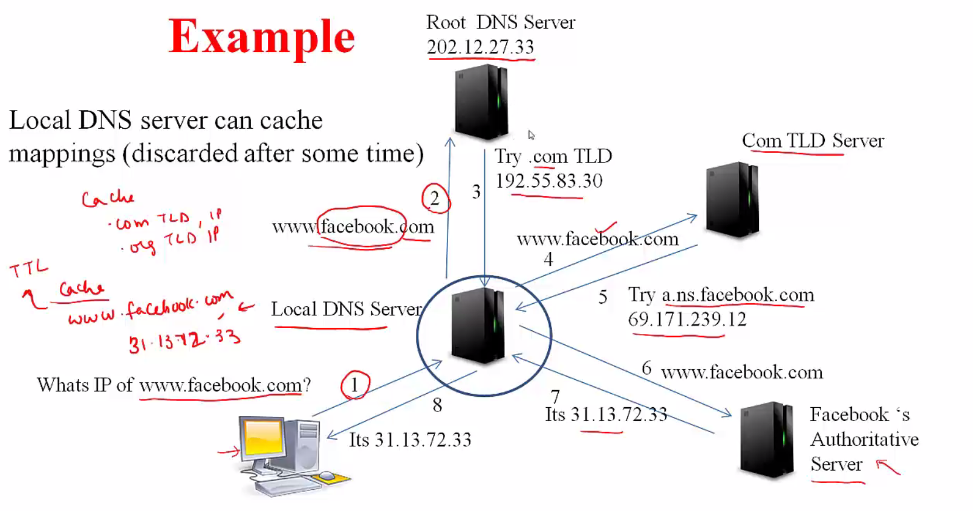

Slide 15
DNS: caching, updating records
once (any) name server learns mapping, it caches mapping
cache entries timeout (disappear) after some time (TTL)
TLD servers typically cached in local name servers
thus root name servers not often visited
cached entries may be out-of-date (best effort name-to-address translation!)
if name host changes IP address, may not be known Internet-wide until all TTLs expire
update/notify mechanisms proposed IETF standard
RFC 2136

Slide 16
DNS records
DNS: distributed db storing resource records (RR)
RR format: (name, value, type, ttl)
type=A
name is hostname
value is IP address
type=CNAME
name is alias name for some “canonical” (the real) name
www.ibm.com is really
servereast.backup2.ibm.com
value is canonical name
type=NS
name is domain (e.g., foo.com)
value is hostname of authoritative name server for this domain
type=MX
value is name of mailserver associated with name

Slide 17
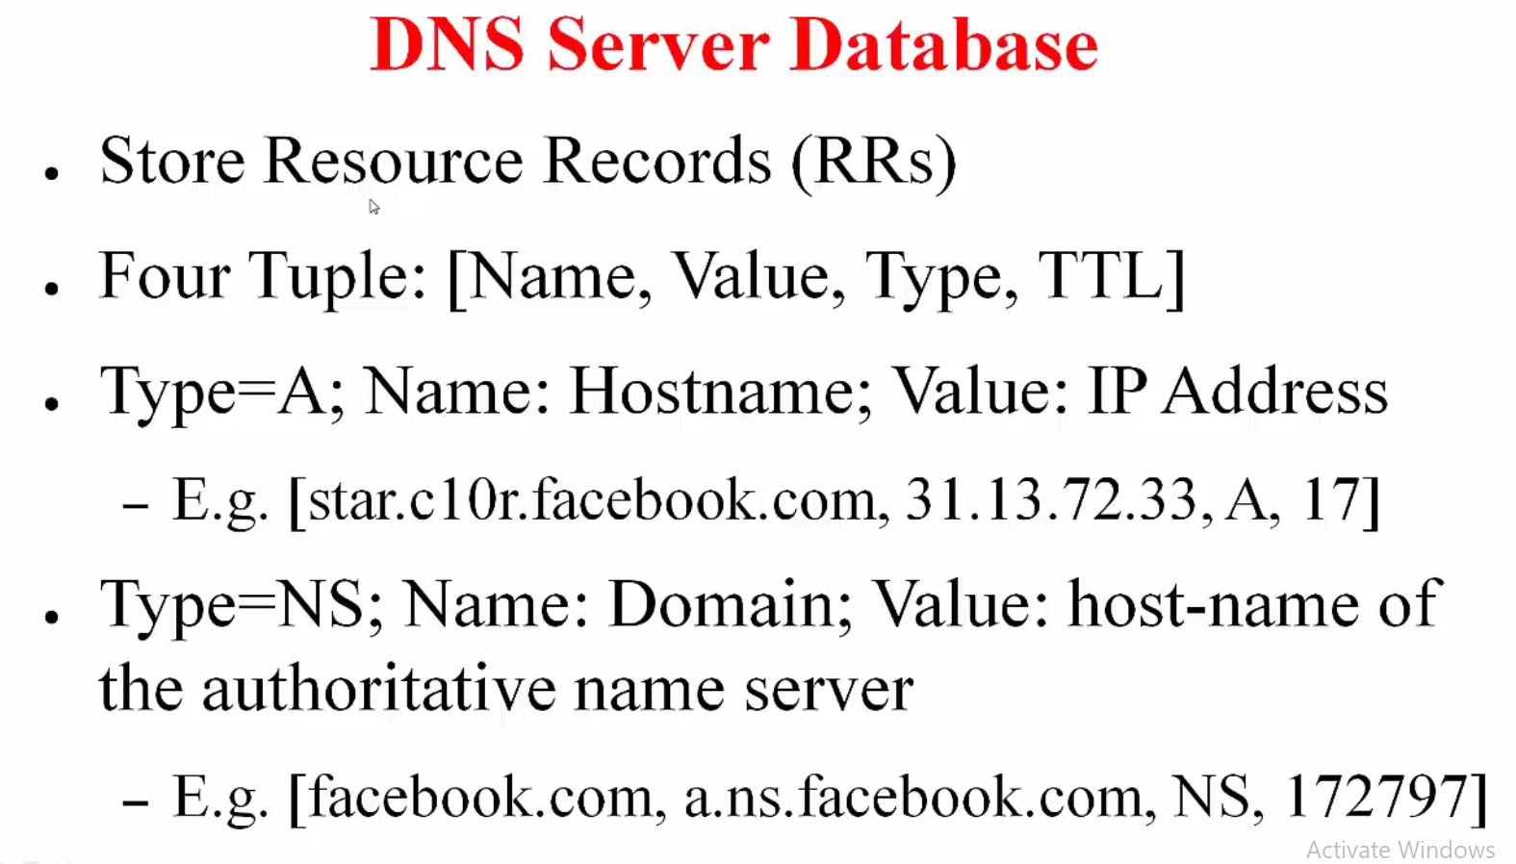

Slide 18
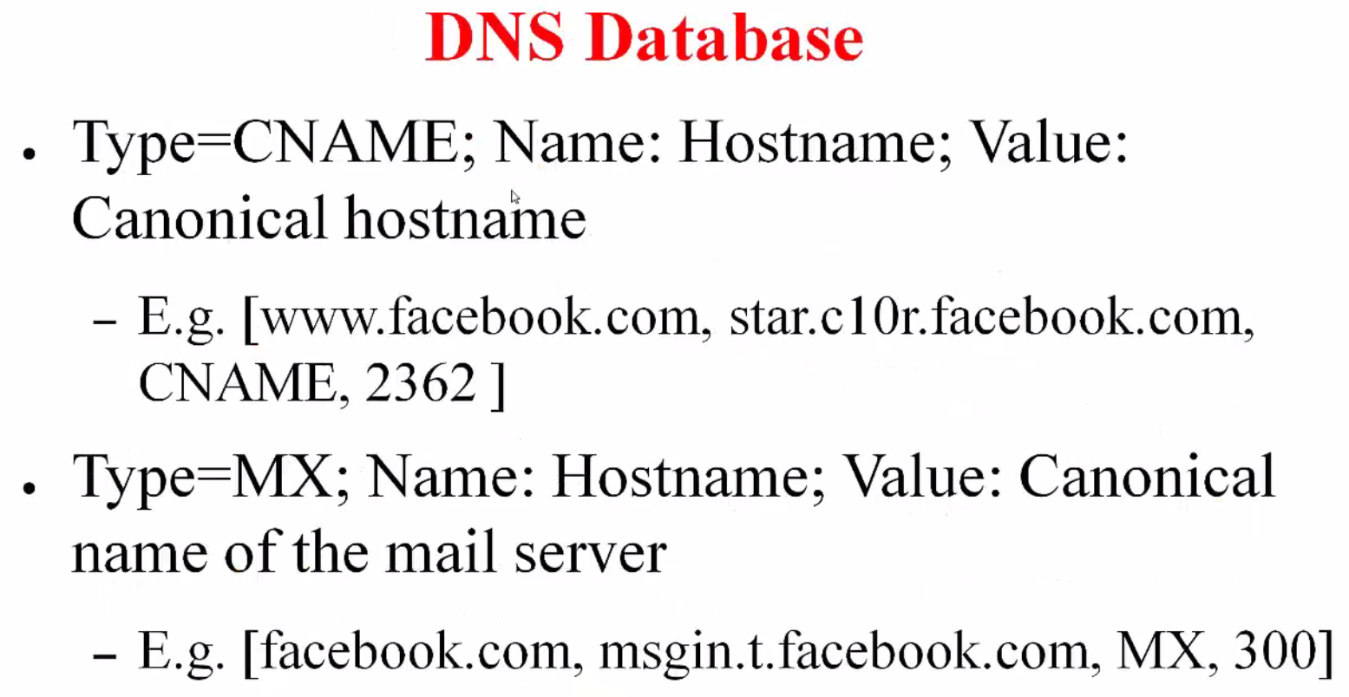

Slide 19
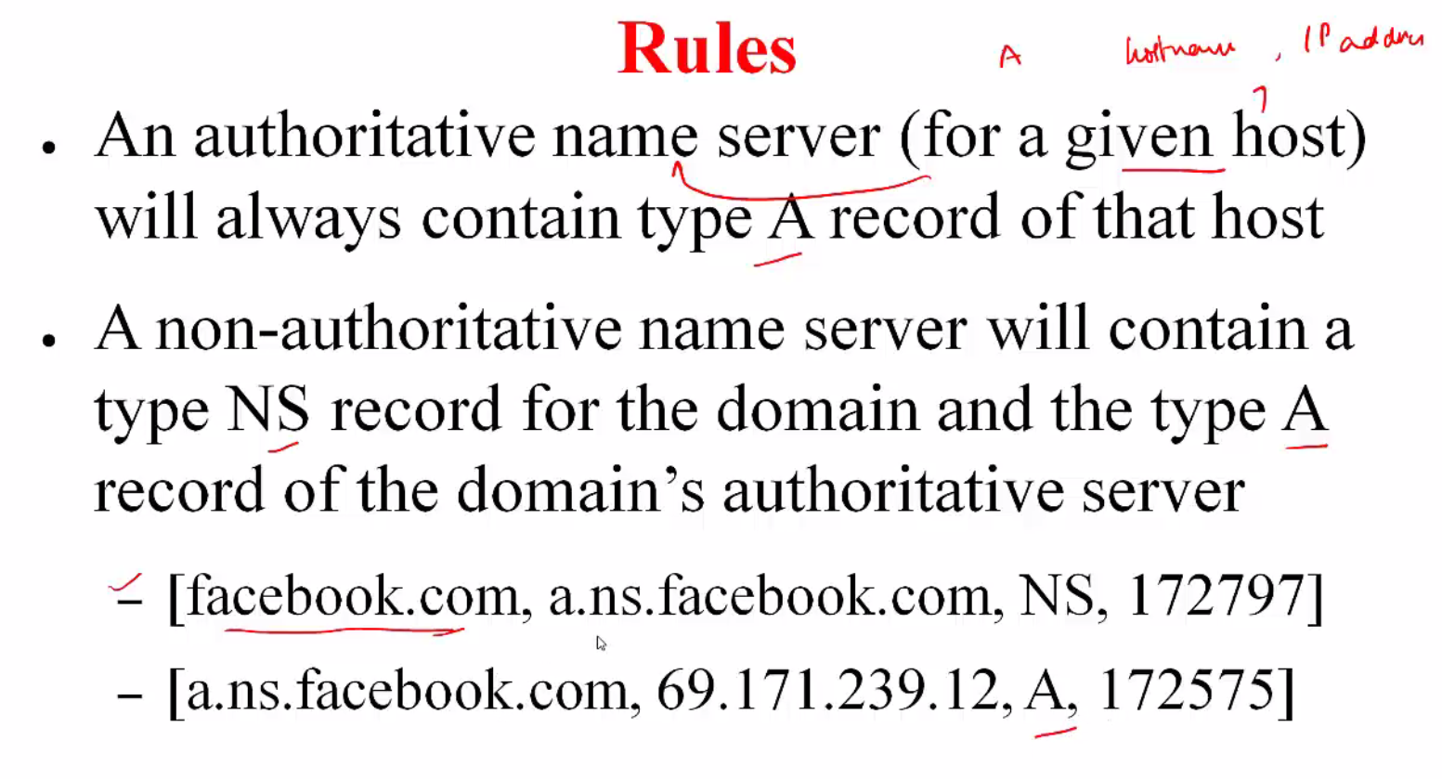

Slide 20
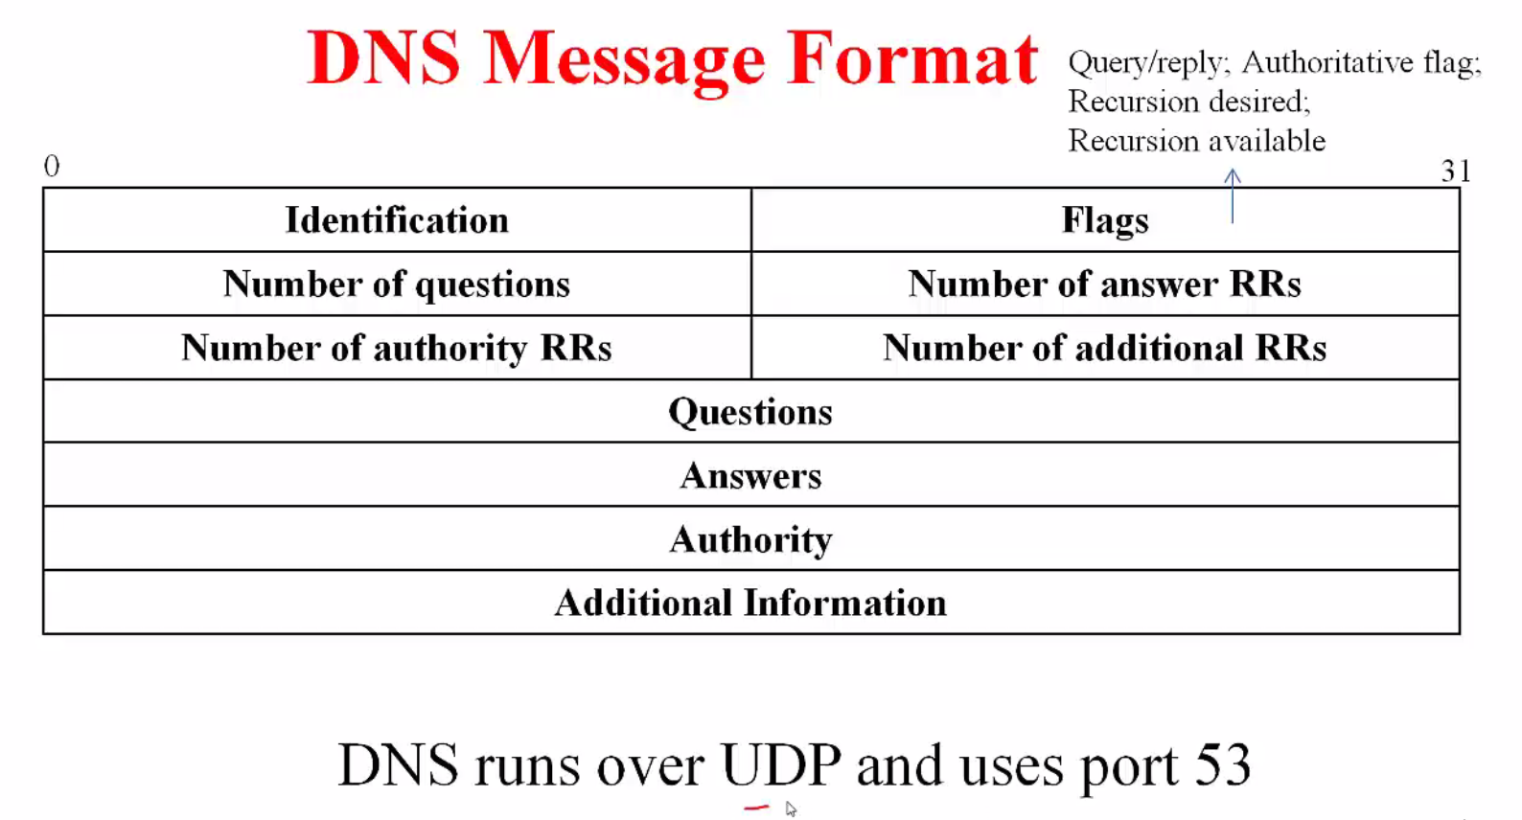

Slide 21

DNS name resolution example
root DNS server
2
host at cis.poly.edu wants IP address for gaia.cs.umass.edu
3
TLD DNS server
4
5
iterated query:
contacted server replies with name of server to contact
“I don’t know this name, but ask this server”
local DNS server
dns.poly.edu
7
6
1
8
authoritative DNS server
dns.cs.umass.edu
requesting host
cis.poly.edu
gaia.cs.umass.edu

Slide 22
DNS name resolution example
root DNS server
2
3
recursive query:
puts burden of name resolution on contacted name server
heavy load at upper levels of hierarchy?
7
6
TLD DNS
server
local DNS server
dns.poly.edu
5
4
1
8
authoritative DNS server
dns.cs.umass.edu
requesting host
cis.poly.edu
gaia.cs.umass.edu

Slide 23
DNS protocol, messages
query and reply messages, both with same message format
2 bytes
2 bytes
msg header
identification: 16 bit # for query, reply to query uses same #
flags:
query or reply
recursion desired
recursion available
reply is authoritative
identification
flags
# questions
# answer RRs
# authority RRs
# additional RRs
questions (variable # of questions)
answers (variable # of RRs)
authority (variable # of RRs)
additional info (variable # of RRs)

Slide 24
DNS protocol, messages
2 bytes
2 bytes
identification
flags
# questions
# answer RRs
# authority RRs
# additional RRs
name, type fields
for a query
questions (variable # of questions)
RRs in response
to query
answers (variable # of RRs)
records for
authoritative servers
authority (variable # of RRs)
additional “helpful”
info that may be used
additional info (variable # of RRs)

Slide 25
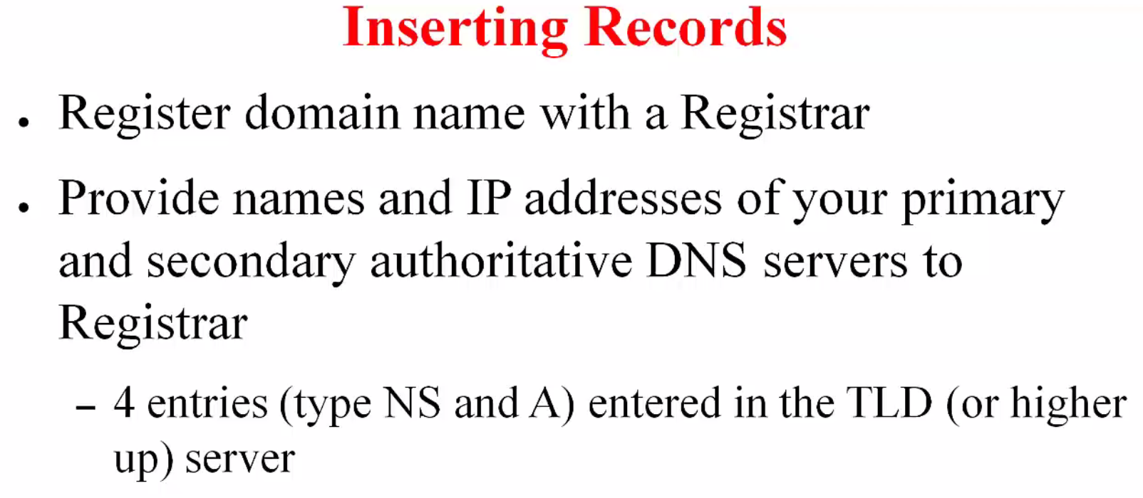

Slide 26
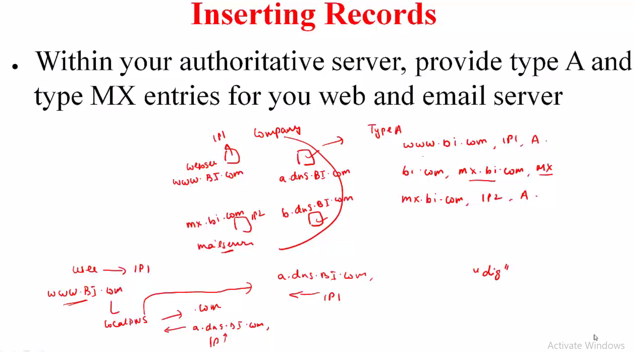

Slide 27
Inserting records into DNS
example: new startup “Network Utopia”
register name networkuptopia.com at DNS registrar (e.g., Network Solutions)
provide names, IP addresses of authoritative name server (primary and secondary)
registrar inserts two RRs into .com TLD server: (networkutopia.com, dns1.networkutopia.com, NS)
(dns1.networkutopia.com, 212.212.212.1, A)
create authoritative server type A record for www.networkuptopia.com; type MX record for networkutopia.com

Slide 28
Attacking DNS
DDoS attacks
Bombard root servers with traffic
Not successful to date
Traffic Filtering
Local DNS servers cache IPs of TLD servers, allowing root server bypass
Bombard TLD servers
Potentially more dangerous
Redirect attacks
Man-in-middle
Intercept queries
DNS poisoning
Send bogus relies to DNS server, which caches
Exploit DNS for DDoS
Send queries with spoofed source address: target IP
Requires amplification

Slide 29
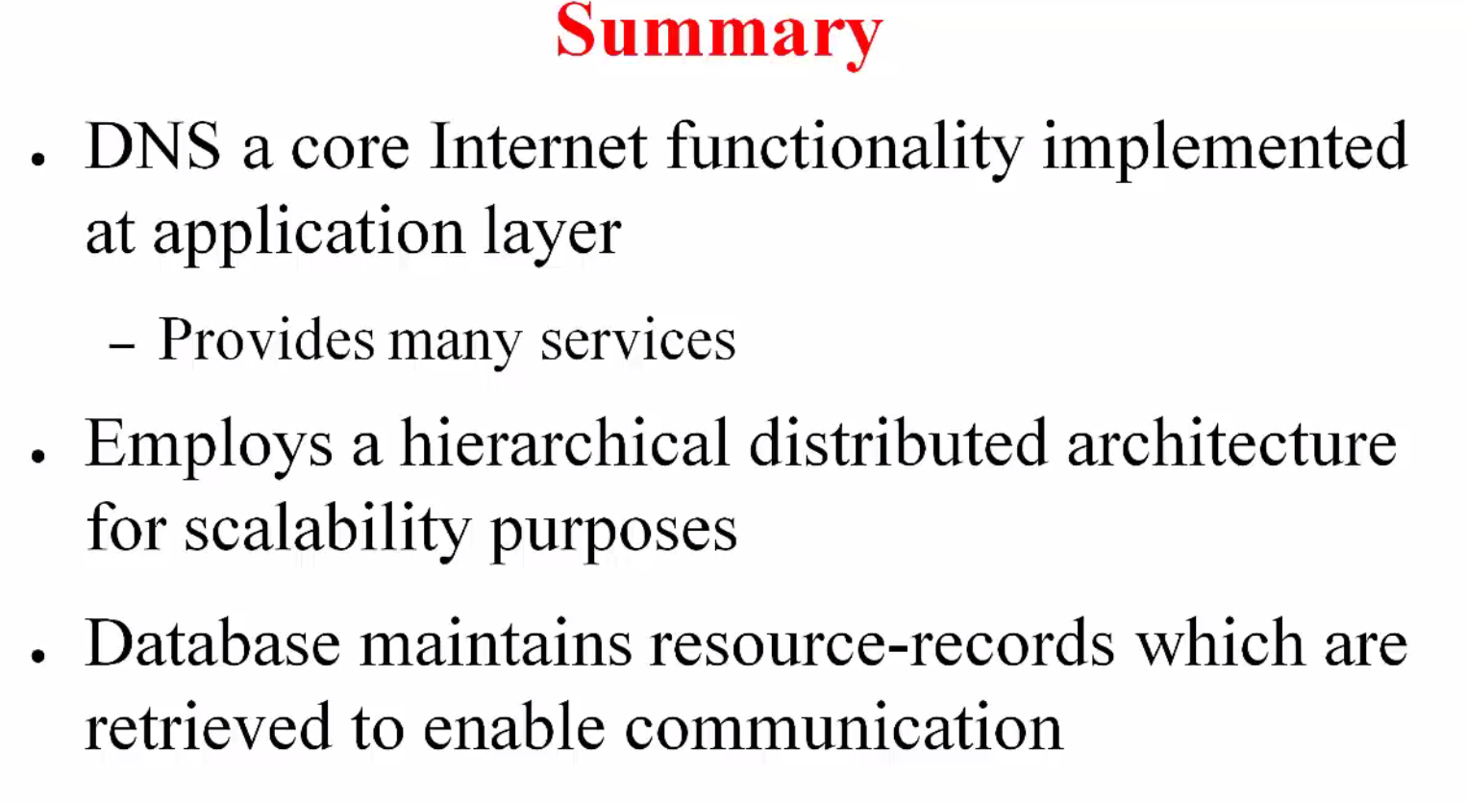

Slide 30
